Slide 1
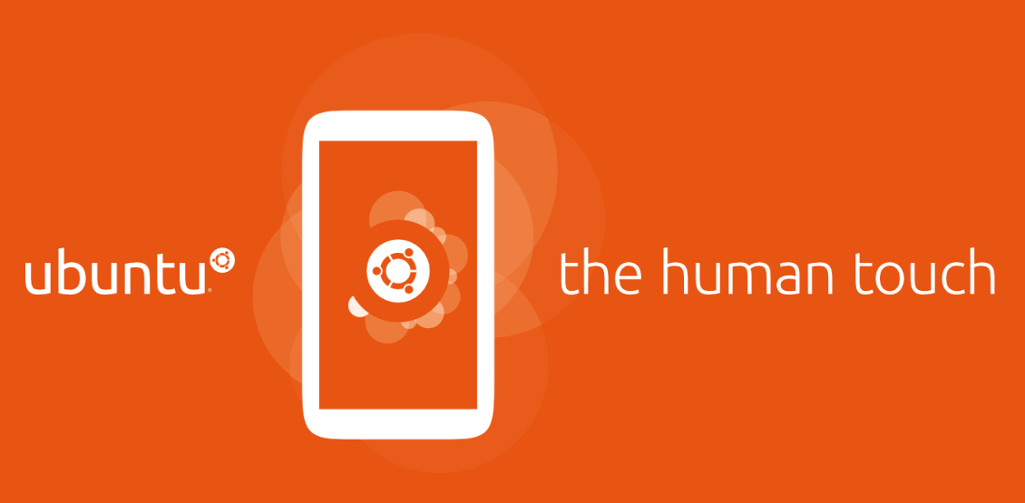
Ubuntu, a potent new force in mobile
Ubuntu App Dev School
Notes:
Introduce yourself. (Update slide with your name and date/name of the event)
Explain, what the talk is going to be about:
Ubuntu Touch, a beautiful open source platform for all form factors (phone, tablet, laptop, desktop, TV)
Choice of technologies (Ubuntu, Qt/QML, Mir, ...)
Solid Ubuntu base.
Great app ecosystem (QML, HTML5, ...)

Slide 2

Ubuntu,
a new force in mobile
Notes:
This talk serves as an introduction to Ubuntu Touch and its app ecosystem.
Introduce yourself.
Explain, what the talk is going to be about:
Ubuntu Touch, a beautiful open source platform for all form factors (phone, tablet, laptop, desktop, TV)
Choice of technologies (Ubuntu, Qt/QML, Mir, ...)
Solid Ubuntu base.
Great app ecosystem (QML, HTML5, ...)

Slide 3
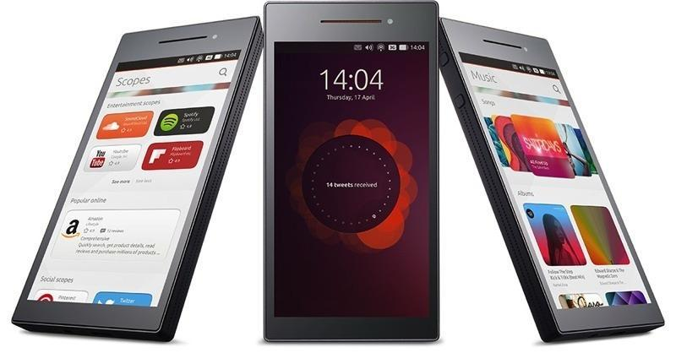
Defining the future of computing
> Ubuntu now runs on smartphones, desktop, servers and powers the cloud
> Brings a fast and beautiful user experience to any phone
> A quality core of apps with a fast-evolving app ecosystem
> Ubuntu SDK with full native and HTML5 support
> Differentiation without fragmentation
(c) 2013 Canonical
Notes:
The Ubuntu operating system is the same, no matter where you run it: improvements immediately benefit all form factors.
Canonical and the Ubuntu community work together on design and implementation.
Daily quality, speed, beauty and consistency were always the focus.
The SDK makes it really easy to put apps together and get them ready for publishing.
The Ubuntu operating system is the same, no matter where you run it: improvements immediately benefit all form factors.
Canonical and the Ubuntu community work together on design and implementation.
Daily quality, speed, beauty and consistency were always the focus.
The SDK makes it really easy to put apps together and get them ready for publishing.

Slide 4

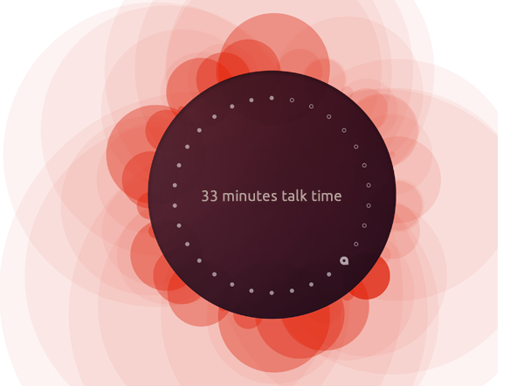
Design vision
A phone you can
see yourself in
Key design themes
> Focus on the content
> Fast and natural interactions
> Sophisticated style
(c) 2013 Canonical
Notes:
The thinking behind Ubuntu for phones considers three important design themes and when you build your apps
Focus on the content
Ubuntu’s gestural interface gives the content or task at hand undivided attention. Everything else is peripheral yet readily available around the edges of the screen.
Fast and natural interactions
Ubuntu’s interactions are based on gestures and the edges of the screen. They give a very natural feel to touch screen interactions and require minimal effort from the user.
Sophisticated style
Smooth, well performing transitions and purposeful animations help the user to understand where they are going and what is happening.
The thinking behind Ubuntu for phones considers three important design themes and when you build your apps
Focus on the content
Ubuntu’s gestural interface gives the content or task at hand undivided attention. Everything else is peripheral yet readily available around the edges of the screen.
Fast and natural interactions
Ubuntu’s interactions are based on gestures and the edges of the screen. They give a very natural feel to touch screen interactions and require minimal effort from the user.
Sophisticated style
Smooth, well performing transitions and purposeful animations help the user to understand where they are going and what is happening.

Slide 5
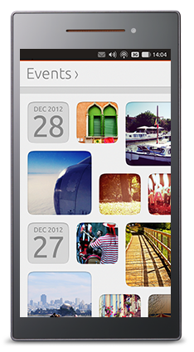
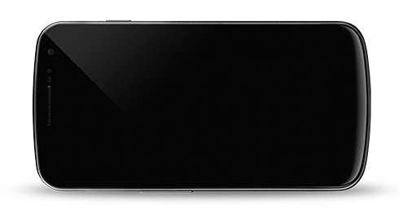

Content, not controls
Design and UX at the core
> Maximised room for content
> Effortless and efficient navigation
> Gestural interface: swipes and edges
> Smart search brings relevant content
> Scopes neatly organise it
(c) 2013 Canonical
Notes:
Room for content: no chrome, just content.
The swipe and edge navigation is obvious and users are familiar with it in no time.
The smart search is always available, powered by scopes and it's continuously improving.
Room for content: no chrome, just content.
The swipe and edge navigation is obvious and users are familiar with it in no time.
The smart search is always available, powered by scopes and it's continuously improving.

Slide 6
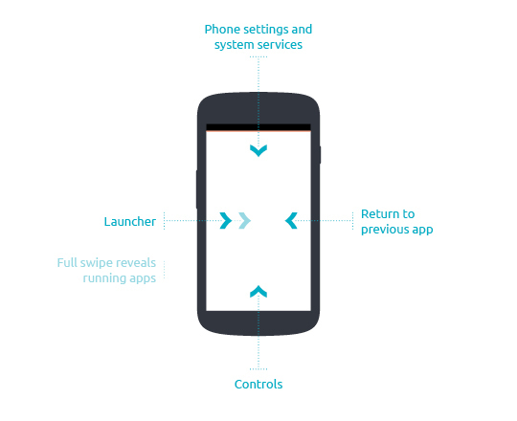
The Ubuntu user experience
> Content is king, more room for what matters
> Simple and intuitive gestures,
use the four edges to navigate
> Right edge to unlock
and switch between active apps
> Left edge reveals the launcher
to quickstart your apps
> Top edge for system indicators
and messaging
> Bottom edge for in-app
controls
> Tip: full right-to-left swipe to see all running apps
(c) 2013 Canonical
Notes:
Indicators and Menu bar - The menu bar holds the system status icons – time and date, volume, network, messaging and battery. These setting indicators can be accessed directly from the top edge.
Return to previous app - A swipe from the right edge of the phone takes you back to the last app you were using. Another swipe takes you back to the application you used before that.
Controls - Swiping up from the bottom edge of the phone reveals app controls. You can hide or reveal them instantly, which means they don’t take up room on the screen.
Launcher and Dash app lens - A short swipe from the left edge of the screen reveals your favourite apps. A full left-to-right swipe reveals a screen showing all your running apps.
Indicators and Menu bar - The menu bar holds the system status icons – time and date, volume, network, messaging and battery. These setting indicators can be accessed directly from the top edge.
Return to previous app - A swipe from the right edge of the phone takes you back to the last app you were using. Another swipe takes you back to the application you used before that.
Controls - Swiping up from the bottom edge of the phone reveals app controls. You can hide or reveal them instantly, which means they don’t take up room on the screen.
Launcher and Dash app lens - A short swipe from the left edge of the screen reveals your favourite apps. A full left-to-right swipe reveals a screen showing all your running apps.

Slide 7
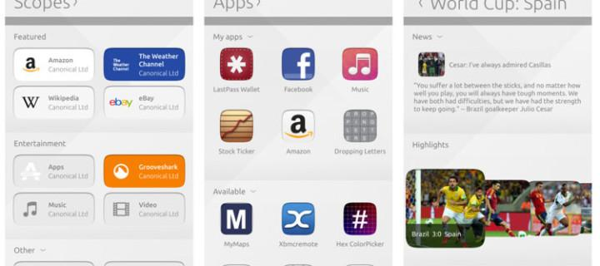
Unity
> Unity is the Ubuntu shell
> To users, it provides a simple, touch-ready UX that brings content at the
forefront with a natural workflow
> To developers, it provides a set of technologies and integration points for
apps to blend into the system
> The Ubuntu SDK makes
Unity integration easy with
a set of clearly-defined APIs
(c) 2013 Canonical
Notes:
Unity is the Ubuntu shell: Unity provides a consistent interface across a variety of form factors. On a new device, users will instantly feel familiar.
Unity integration: As an app developer, you can hook up your application with Unity easily and make your app well-integrated into the general exerience.
Unity is the Ubuntu shell: Unity provides a consistent interface across a variety of form factors. On a new device, users will instantly feel familiar.
Unity integration: As an app developer, you can hook up your application with Unity easily and make your app well-integrated into the general exerience.

Slide 8
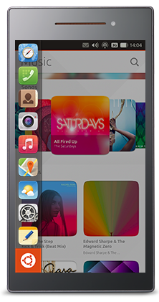
Unity
> The Launcher is revealed with a left swipe
> Contains quick access to favourite apps
> Shows currently active apps and can
switch between them
> Apps can be rearranged or pinned to the
Launcher with a long press
> The above integration comes for free
> Additional integration points
> Count indication
> Progress indication
> Urgency indication
(c) 2013 Canonical
Notes:
The launcher is intuitive and provides fast access to apps and can be adapted easily by the user.
Integration: Relevant status information (progress of an operation, message count, urgency of a request by the app) is visible in one glance at the launcher.

Slide 9
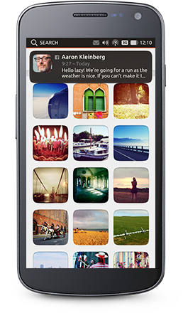
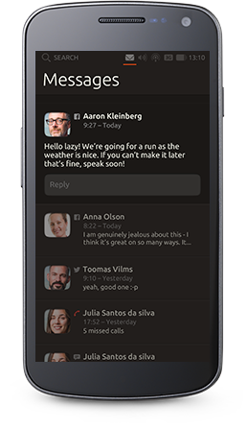
Unity
> Indicators provide quick and consistent
access to frequent system functions
> Notifications from various sources
are unified in the notification center
> Tap once on an app indicator to scrub
left and right through the other ones
> Notify OSD provides unintrusive,
dismissable or actionable notifications
with snap decisions
> Integration points
> Message counts
> Activity notification
(c) 2013 Canonical
Notes:
Indicators are always and easily accessible at the top of the screen.
The collection of indicators includes: messages, battery, network, bluetooth, date/time, location, sound.
Apps can issue notifications and show messages in the message indicator, which are immediately actionable.
Indicators are always and easily accessible at the top of the screen.
The collection of indicators includes: messages, battery, network, bluetooth, date/time, location, sound.
Apps can issue notifications and show messages in the message indicator, which are immediately actionable.

Slide 10
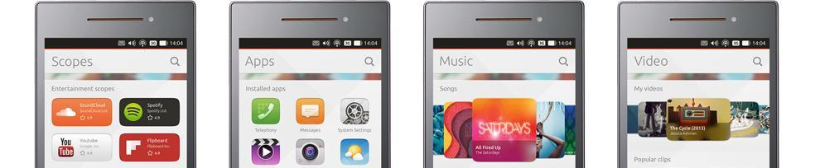
Unity
> Scopes bring relevant content to users via search plugins
> Aggregating scopes organize the content and act as containers
for multiple related scopes
> Highly modular, scopes enable customisation of the environment
without platform modification
> Tip: in the Scopes view, you can pull up the “Scope management” screens from the bottom.
(c) 2013 Canonical
Notes:
Local or online content is always just one keypress away.
Scopes can easily be added and through the smart scopes server results get better all the time.
Local or online content is always just one keypress away.
Scopes can easily be added and through the smart scopes server results get better all the time.

Slide 11
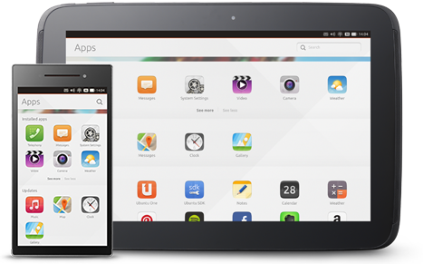
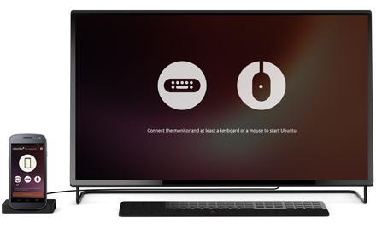
Convergence
Run Ubuntu everywhere
> Handheld PCs
are the future of personal computing
> Today’s smartphones and tablets
are as powerful as ultra-light laptops
> Ubuntu designed from the ground up
to run across devices and form factors
> The UI and the UX metaphors
naturally adapt to different screen sizes
> Ubuntu paves the way
for a new category of superphones
> Just dock your device
to a monitor and keyboard
(c) 2013 Canonical
Notes:
With Ubuntu, the industry’s first fully converged device will be a high-end smartphone that can be docked to a monitor and keyboard to become a powerful desktop PC.
This is made possible because we have a very deep level of integration between the services on the phone and the desktop – underneath, it is really the same OS. This is a real strength of Ubuntu.
With Ubuntu, the industry’s first fully converged device will be a high-end smartphone that can be docked to a monitor and keyboard to become a powerful desktop PC.
This is made possible because we have a very deep level of integration between the services on the phone and the desktop – underneath, it is really the same OS. This is a real strength of Ubuntu.

Slide 12
A fast-evolving
app ecosystem

Slide 13

App developers are key
Ubuntu provides an end-to-end developer story
> Full Ubuntu SDK
> Native and web apps are first-class citizens
> Comprehensive developer site
with documentation, tutorials, cookbooks
and API reference
> Detailed online app design guides
to make your apps Ubuntu
> Easy and secure app upload process
to the Software Store
> Seamless app distribution and installation in the store view
> A vibrant and enthusiastic community of developers
(c) 2013 Canonical
Notes:
Despite being a young player, full developer story.
Along with a strong design vision, the app developer story has been a driver behind Ubuntu Touch.
Getting information and help for writing Ubuntu apps is easy and getting it into the store is even easier.
Despite being a young player, full developer story.
Along with a strong design vision, the app developer story has been a driver behind Ubuntu Touch.
Getting information and help for writing Ubuntu apps is easy and getting it into the store is even easier.

Slide 14
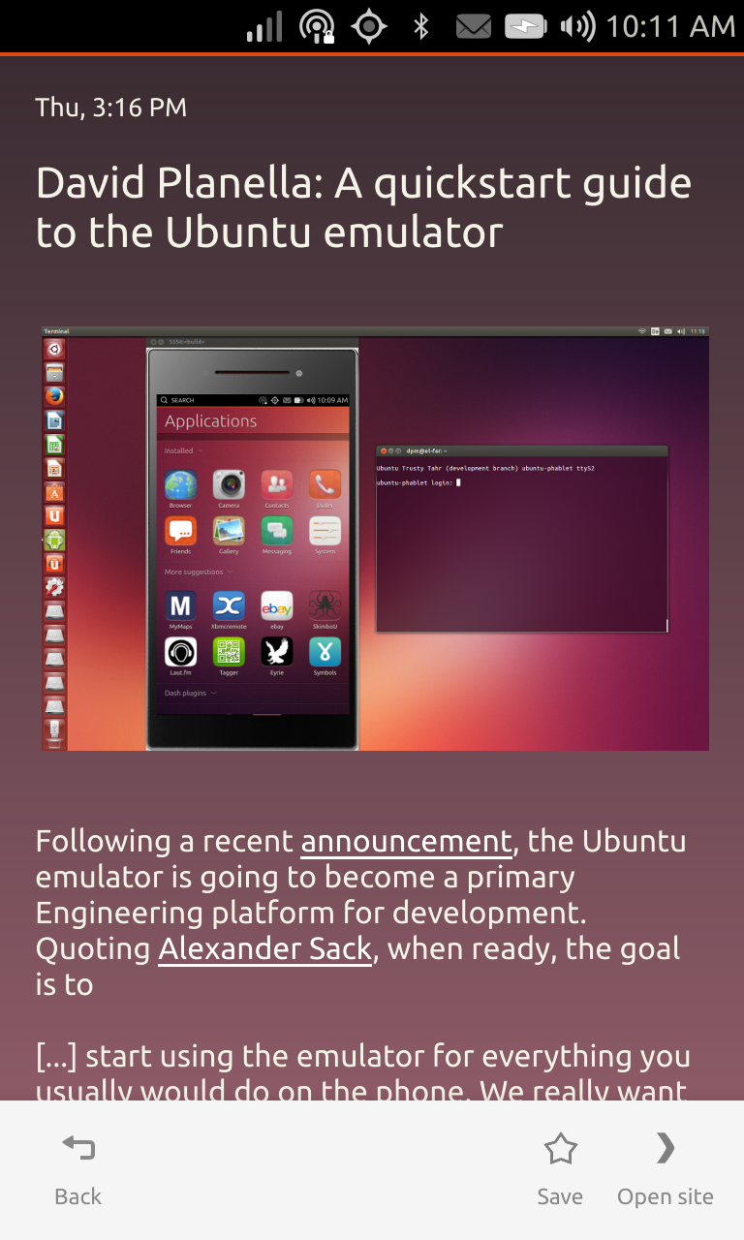
A quality core of apps
Ubuntu comes with batteries included
> From Browser to Camera to anything in
between
> Around 20 core apps are installed by default
> Core apps provide essential functionality
for everyday phone use
> Community-driven development
together with the Canonical
Design Team
> The Ubuntu app ecosystem grows
with more 3rd-party apps to
cover any additional needs
(c) 2013 Canonical
Notes:
Ubuntu on any device is instantly functional. All the standard needs of users are catered to by core apps.
Large community brings apps in daily quality.
More apps being published in the app store every day.
Ubuntu on any device is instantly functional. All the standard needs of users are catered to by core apps.
Large community brings apps in daily quality.
More apps being published in the app store every day.

Slide 15
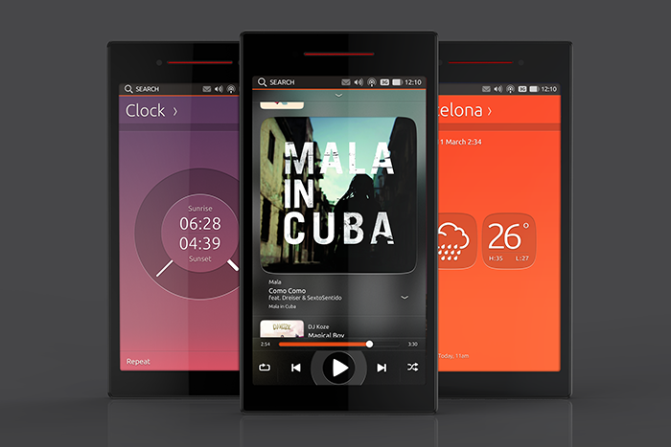
Ubuntu is community
> Ubuntu is planned and developed in the open, you can influence it too!
> 12 core apps were created by teams of community volunteers
(c) 2013 Canonical
Notes:
Ubuntu is very special in the mobile world. Plans are put together in public discussions every three months. Specifications, code, review, QA and everything else is done publicly by a passionate community.
Ubuntu is very special in the mobile world. Plans are put together in public discussions every three months. Specifications, code, review, QA and everything else is done publicly by a passionate community.

Slide 16



The Ubuntu SDK
Ubuntu features a full-blown Software Development Kit
> The SDK enables developers to create and maintain apps
throughout their full lifecycle, from start to publish
> Holistic approach: a powerful IDE with device access,
a GUI toolkit and extensive documentation, all included
> Based on the proven and popular Qt framework
and development toolset
> Programming languages are QML, Javascript
and optionally C++.
> The web is also a first class citizen, with different degrees
of integration: webapps, HTML5 foundations and HTML5
platform access
(c) 2013 Canonical
Notes:
Installing the Ubuntu SDK is easy. It comes with documentation, examples, tools to test on the device, publish your app and lots more.
The choice of technologies makes it easy for newcomers. Use QML (a simple but powerful, declarative language) and JavaScript and put your app together in next to no time.
Use HTML5 if that's your thing, or use C++ if you're comfortable with that and/or want to access low-level libraries.
Installing the Ubuntu SDK is easy. It comes with documentation, examples, tools to test on the device, publish your app and lots more.
The choice of technologies makes it easy for newcomers. Use QML (a simple but powerful, declarative language) and JavaScript and put your app together in next to no time.
Use HTML5 if that's your thing, or use C++ if you're comfortable with that and/or want to access low-level libraries.

Slide 17
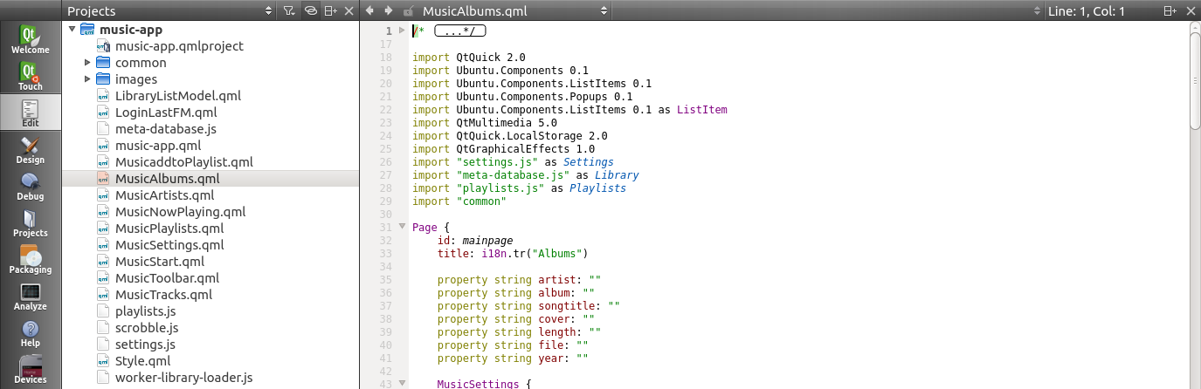
The Ubuntu SDK
Qt Creator is the SDK’s Integrated Development Environment (IDE)
> A feature-rich IDE for advanced code editing
> Intuitive visual debugger
> Device connectivity: easily run apps on the phone during development
> Emulator and graphical click app packager
(c) 2013 Canonical
Notes:
The SDK makes development easy:
Find available attributes and functions of object easily
Run apps on a device through just a click
Package apps easily
It comes with example apps and API documentation.
You can easily use version control for your projects.
The debugger is easy to use.
The SDK makes development easy:
Find available attributes and functions of object easily
Run apps on a device through just a click
Package apps easily
It comes with example apps and API documentation.
You can easily use version control for your projects.
The debugger is easy to use.

Slide 18
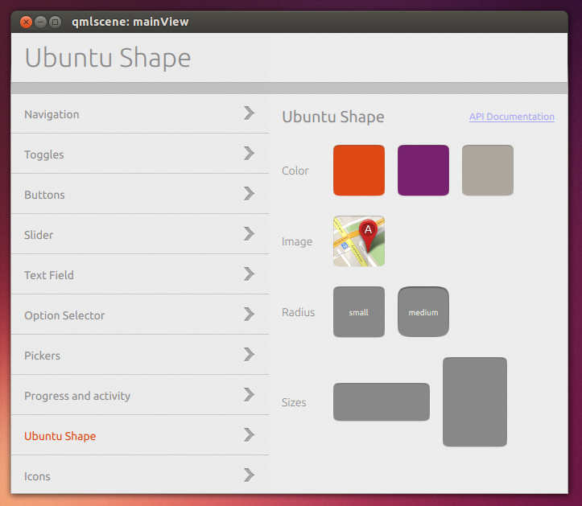
The Ubuntu SDK
The UI Toolkit provides widgets for the unique Ubuntu look and feel
> A collection of the essential
building blocks to create Ubuntu apps
> Carefully crafted by designers
and implemented by developers
> The toolkit's widgets enable
visual and behavioural integration
> Not a requirement to use the toolkit,
but strongly recommended
for the best integration
and UX consistency
> Written in QML, there is also an HTML5 theme available
> Use the Showcase app to see the toolkit in action
(c) 2013 Canonical
Notes:
Some use cases for the terminal:
Read logs of a running app on the phone
Quickly run an app on the desktop without starting Qt Creator
Flash a device with a development image

Slide 19

Native and web-based apps
Native or web, your choice
> Full support for both native and HTML5
> Go native for the best integration or for
resource-demanding applications
> Go web to use Internet technologies or
to port existing HTML5 apps
> Hosted – Web apps for site integration
> Local – HTML5 foundations for most needs
> Local – HTML5 platform access for device integration
(camera, sensors…)
(c) 2013 Canonical
Notes:
HTML5 and native apps are “equal citizens”
An application written in HTML as a web application will have its own UI context running Ubuntu meaning it can run independently of the browser (so if the main browser is closed, the web application will continue to run).
Ubuntu also defines different levels of UI integration which web applications can benefit from to give the user a more integrated experience – this is especially useful for social media and multimedia web applications.
It means the web app can surface alerts and notifications using standard Ubuntu UI elements such as the notifications menu.
As “equal citizens” we allow web apps to behave in the same way as native applications, so they may share the same system resources to ensure performance and share the same customisations.
HTML5 and native apps are “equal citizens”
An application written in HTML as a web application will have its own UI context running Ubuntu meaning it can run independently of the browser (so if the main browser is closed, the web application will continue to run).
Ubuntu also defines different levels of UI integration which web applications can benefit from to give the user a more integrated experience – this is especially useful for social media and multimedia web applications.
It means the web app can surface alerts and notifications using standard Ubuntu UI elements such as the notifications menu.
As “equal citizens” we allow web apps to behave in the same way as native applications, so they may share the same system resources to ensure performance and share the same customisations.

Slide 20
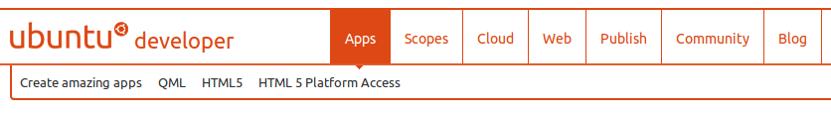
The Ubuntu SDK
developer.ubuntu.com is the information hub for creating Ubuntu content
> A central resource for guides and learning material
to write apps, scopes, website integration and cloud charms
> Each area includes technology overviews, tutorials, a cookbook with
developer recipes and API references
> The developer blog features news and interesting updates
around Ubuntu app development
> Provides access to the Software Store to publish
and maintain Ubuntu apps
> A gateway to community support on askubuntu.com:
an Ubuntu Q&A website powered by Stack Exchange
(c) 2013 Canonical
Notes:
developer.ubuntu.com is a great resource for everyone who wants to create content for Ubuntu.
Written by experts
All sections follow a similar layout: learn the basics, get set up, work through a simple tutorial, find more examples and find more in-depth articles about advanced topics.
Offers different ways to get in touch with other developers and creators of the platform.
developer.ubuntu.com is a great resource for everyone who wants to create content for Ubuntu.
Written by experts
All sections follow a similar layout: learn the basics, get set up, work through a simple tutorial, find more examples and find more in-depth articles about advanced topics.
Offers different ways to get in touch with other developers and creators of the platform.

Slide 21
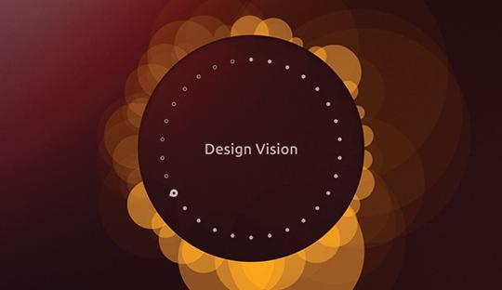
The Ubuntu SDK
The design guides help making applications “Ubuntu”
> An online resource that grows organically together with the toolkit
> Covers behavioural patterns as well as individual building blocks
> design.ubuntu.com/apps
(c) 2013 Canonical

Slide 22
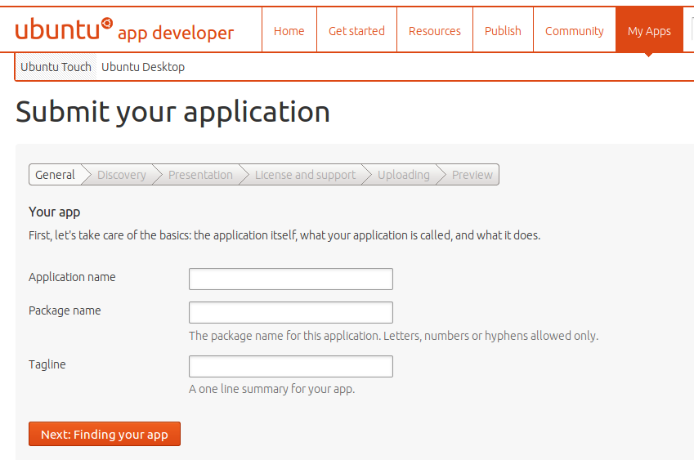
The Ubuntu Software Store
Use the Store to publish and distribute Ubuntu apps
> The store is now open for submissions, simple to use and supporting
remote installation and app updates
> Effortless submission process: create click packages with the SDK,
register for free to the developer site and submit
> Seamless system integration: available software installable
and discoverable in the store view of the apps scope
> Upgrades via the system settings
> myapps.developer.ubuntu.com
(c) 2013 Canonical
Notes:
The app store and app format were created after years of experience with software distribution.
Through confinement apps are secure by default.
Apps are available instantly after a review. This process is going to be refined and simplified even more.
The app store and app format were created after years of experience with software distribution.
Through confinement apps are secure by default.
Apps are available instantly after a review. This process is going to be refined and simplified even more.

Slide 23
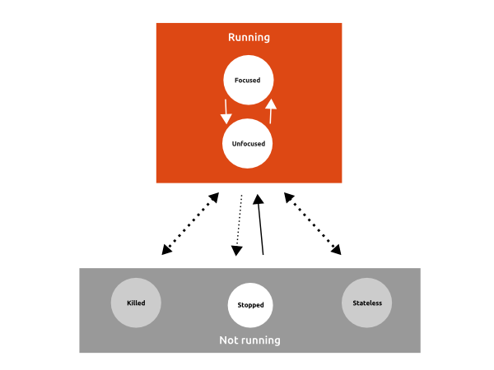
The Ubuntu application model
New application model, optimized and secure
> Applications are isolated
and protected from each other by default
> Takes advantage of platform technologies,
notably AppArmor
> Applications must ask permission
to the OS to access user data
> Optimized to save battery life
and memory usage
background applications are suspended,
unless they explicitly require it via dedicated APIs
> Simplified installation and packaging
the application integrates its own dependencies (libraries)
uninstalling the app removes them as well
(c) 2013 Canonical
Notes:
The picture shows the application lifecycle. Every app is treated the same. Only one app is considered to be running at a time. Everything that is running “in the background” is done by a service provided by the platform.
Permissions of apps are specified in a manifest, which are approved during the submission to the app store.
The picture shows the application lifecycle. Every app is treated the same. Only one app is considered to be running at a time. Everything that is running “in the background” is done by a service provided by the platform.
Permissions of apps are specified in a manifest, which are approved during the submission to the app store.

Slide 24
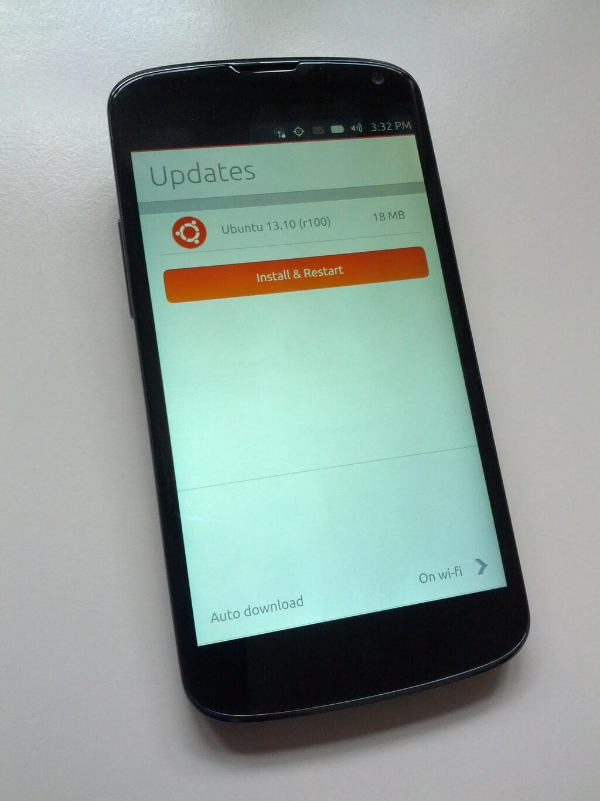
Delivering secure and reliable updates
New software update system, optimized for mobiles
> The operating system is made of a single base image file, built from a
set of Ubuntu packages
> Updates are computed and distributed
Over-The-Air (OTA) in delta form
> Variable update frequency,
with multiple update channels
> The base OS is unalterable
once the device has booted
> Applications are distributed
and updated
independently from the base OS
(c) 2013 Canonical
Notes:
Code changes have to pass the test suite of a component, then peer review. Then packages are built, of which updated images are built.
The images are built in a regular fashion and are then automatically tested on a variety of devices in a test lab. When all the integration tetst pass the images are published and delta updates are available for download.
Code changes have to pass the test suite of a component, then peer review. Then packages are built, of which updated images are built.
The images are built in a regular fashion and are then automatically tested on a variety of devices in a test lab. When all the integration tetst pass the images are published and delta updates are available for download.

Slide 25
For operators
and OEMs

Slide 26

Taking Ubuntu to market
Backed by Canonical
> Daily engagements with OEMs, ODMs
and mobile operators
> Strong hardware enablement partnerships
with top brands
> All major OEMs partnered up with
Canonical.
> Experts in Linux on ARM since 2008
> Custom engineering
(c) 2013 Canonical
Notes:
Original Equipment Manufacturer. A company that produces hardware to be sold under another company's brand.
An original design manufacturer (ODM) is a company which designs and manufactures a product which is specified and eventually branded by another firm for sale.
Original Equipment Manufacturer. A company that produces hardware to be sold under another company's brand.
An original design manufacturer (ODM) is a company which designs and manufactures a product which is specified and eventually branded by another firm for sale.

Slide 27
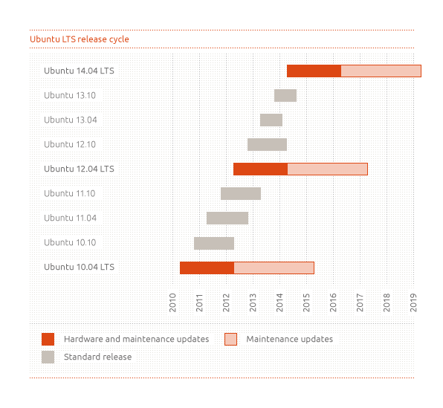
A cadence to rely upon
> Ubuntu is released every six months
> The first phone release was 13.10
> Regular releases are supported
for 9 months
> Long Time Support (LTS) releases
are supported for 5 years
> The next Ubuntu 14.04 will be
a Long Time Support (LTS) release
> Stable releases use the
year.month version naming convention (e.g. 14.04)
> Development releases use the Awesome Animal naming convention
(e.g. Trusty Tahr)
> Nine years, 19 releases – all on time
(c) 2013 Canonical
Notes:
We boot directly into Ubuntu and then run the Android HAL (Hardware Abstraction Layer) in a container to make use of the binary drivers and some daemons that are needed to drive the built-in hardware of a phone

Slide 28
Run Ubuntu on any phone
System requirements for smartphones | Entry-level Ubuntu smartphone | “Superphone” that can be a PC
Processor architecture | Dual-core Cortex A9 or similar | Quad-core A9 or Intel Atom
Memory | 512 MB - 1 GB | Min 1 GB
Flash storage | 4 - 8 GB eMMC + SD | Min 32 GB eMMC + SD
Multi-touch
Desktop convergence
Stunning design on any smartphone
> Fast and beautiful experience on inexpensive hardware
> Core applications run at full native speeds, no JVM overhead
> Even on mid-range, Ubuntu delivers fast content results
> On high end, dock your device to enjoy a full personal computing experience
(c) 2013 Canonical
Notes:
Ubuntu supports all the different smartphone segments. At the high end, it creates an entirely new ‘superphone’ category with converged devices that act as phones on the move, but with full PC functionality when docked with a keyboard and monitor. Ubuntu is also great for aspirational consumers who want a superior experience, with faster, richer performance on lower cost smartphones.
We are filling some real market gaps with an innovative platform for a new category of ‘superphone’ as well as providing a much richer experience for entry level phones.
Not only is Ubuntu backed by a strong app ecosystem, it brings great new capabilities including a superb user experience, strong OEM support, customization opportunities and an ability to support all hardware from the low end to the most highly specified smartphones.
Ubuntu supports all the different smartphone segments. At the high end, it creates an entirely new ‘superphone’ category with converged devices that act as phones on the move, but with full PC functionality when docked with a keyboard and monitor. Ubuntu is also great for aspirational consumers who want a superior experience, with faster, richer performance on lower cost smartphones.
We are filling some real market gaps with an innovative platform for a new category of ‘superphone’ as well as providing a much richer experience for entry level phones.
Not only is Ubuntu backed by a strong app ecosystem, it brings great new capabilities including a superb user experience, strong OEM support, customization opportunities and an ability to support all hardware from the low end to the most highly specified smartphones.

Slide 29
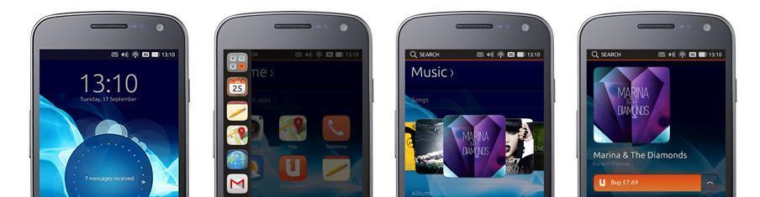
Customise to your needs
Integrate to differentiate
> Built-in branding opportunities without platform and UX modifications
> True service-layer differentiation for OEMs, with Scopes at the core
> Prioritise search results to highlight your content
> Connect your store to the Apps or Music scope
with integrated online payment
(c) 2013 Canonical

Slide 30
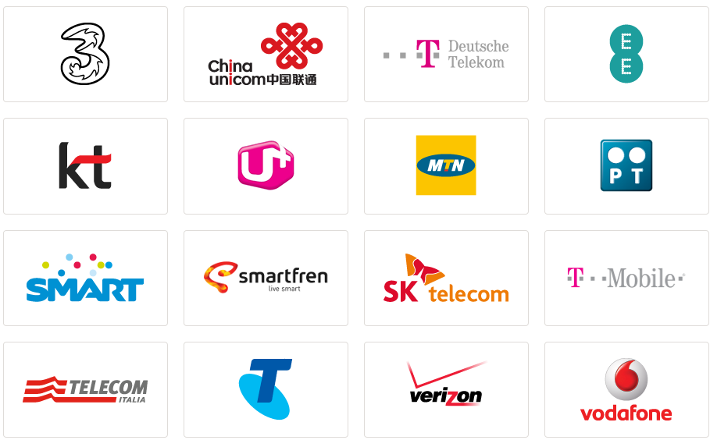
The Ubuntu Carrier Advisory Group
> The CAG enables mobile operators to shape Ubuntu’s mobile strategy
> Members receive advance confidential briefings and provide
industry insights to ensure Ubuntu meets their needs
> Opportunity to be a launch partner and ship Ubuntu in their markets
(c) 2013 Canonical
Notes:
Three.co.uk
China Unicom
Deutsche Telekom
Everything Everywhere
Korea Telecom
LG Uplus
Portugal Telecom
MTN Group
Smartfren
SK Telecom
T Mobile
Telecom Italia
Telstra
Verizon Wireless
Three.co.uk
China Unicom
Deutsche Telekom
Everything Everywhere
Korea Telecom
LG Uplus
Portugal Telecom
MTN Group
Smartfren
SK Telecom
T Mobile
Telecom Italia
Telstra
Verizon Wireless

Slide 31

Thank you and stay in touch!
> joeychan.ubuntu@gmail.com
新浪微博 @敲代码的Joey_Chan

